Slide 1
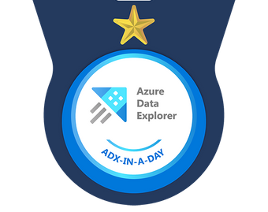

Welcome to Azure Data Explorer in a day

Slide 2
Welcome to Azure Data Explorer in a day
Hello!!
مرحبا
नमस्ते
こんにちは
ہیلو
你好
Notes:
Hello and Welcome
Thanks for overwhelming response
May event to be announced
Fun and Challenge Filled 8 hours
Growth Mindset

Slide 3
Guidelines
**When you join this virtual engagement, your name, email address and/or phone number may be viewable by other session participants in the attendee list. By joining, you’re agreeing to this experience.**
If you are using Teams app with an organizational account, you will have access to Polls and Q&A features. For users who do not use Teams app, you will not have access to Polls and Q&A
Please use the chat responsibly. We reserve the right to moderate the chat and take the extreme action of removing the participant.
Please use "Raise Hand" 🤚feature if you would like to speak up. We will unmute you.
Participants that cannot submit answers to the polls are requested to put the answers in the chat
Participants that do not have access to Q&A feature of Teams can put the questions in the chat and add "❓" reaction to it. If the participant is not able to add "❓", then the proctor will mark the question with "❓" reaction. When the question is answered, that reaction will be marked with "✅“
Questions that were not answered on the chat will be answered in a blog post soon after the event.

Slide 4

Agenda – High level
First Half
Intro (5 mins)
Presentation (1 hr)
Break (10 min)
Lab 1 Challenges 1-4
Lunch (30 mins)
Second Half
Regroup (5 mins)
Presentation (45 mins)
Break (10 mins)
Lab 2 Challenges (5-8)
Closing (15 mins)
Notes:
Agenda can be spread in-half across 2 days with a presentation and 2 labs.
Do Q&A throughout.
Start at 9:30 AM
Break 10min
Lunch at :01:00 PM
Back from Lunch at: 1:45 PM
Break 10 min
Close by 05:30 PM
1st Presentation – ADX intro, Positioning, Competes, Customer Stories, KQL, Schemas, Update Policies
2nd Pressenation - Presentation – ADX Schemas, Timeseries Analysis, Machine Learning

Slide 5

















































Telemetry: Key data for digital transformation
Physical World
Manufacturing
Energy
Retail
Healthcare
Digital World
High Frequency
High Volume
High Velocity
Schema Drift
Semi-structured + Free Text
Immutable
Low Latency
Telemetry, timeseries, tags
Logs, traces, metrics
Telco
Automotive
Financial Services
Media & Entertainment
Audit Logs
Activity Logs
Access Logs
Notes:
Industries :
Telemetry from manufacturing industries- Locomotives, food processing equipment, Industrial IOT, smart buildings, connected factories
Energy customer using telemetry from power plants, wind turbines solar to perform analysis on plant performance and maintenance
Automotive industry uses ADX for racing telemetry, fleet management, real time road safety
Retail Industry to digitalize shopping carts, delivery tracking
Media and Entertainment to track clickstream data, ad campaigns, personalized content
Digital World:
Different kinds of logs and traces like Database logs, Security logs, audit traces, system events and more
Logs, traces, metrics, audit trails

Slide 6

Introducing Azure Data Explorer!
Any append-only stream of records
High volume
High velocity
High variance (structured, semi-structured, free-text)
Relational query model:
Filter, aggregate, join, calculated columns, …
Fully-managed
PaaS, Vanilla, Database
A big data analytics cloud platform optimized for interactive, ad-hoc queries
Purposely built
Rapid iterations to explore the data
Notes:
Big Data – Data that has High Volume, Velocity, variety – Structured, Semi-Structured, free text data. Append only DB.
Analytics – Can have relational query model with tables, columns, joins, filters and aggregates.
Cloud Platform – Platform as as Service where we don’t have to take care of infrastructure. With little configuration of Scale we can provision cluster, DB and start working with it. We can take care of scaling using autoscale or you can use manual scale.
Optimized – any data that is timestamped can fit right into ADX. It is optimized for timeseries data. All columns are compressed and indexed.
Interactive , ad hoc queries – ADX has native Kusto Query Language for gaining data insights. Has some similarity to SQL in terms of operators/joins etc Use KQL to – finding patterns, trends, forecasting, anomalies etc. Create near realtime dashboards

Slide 7
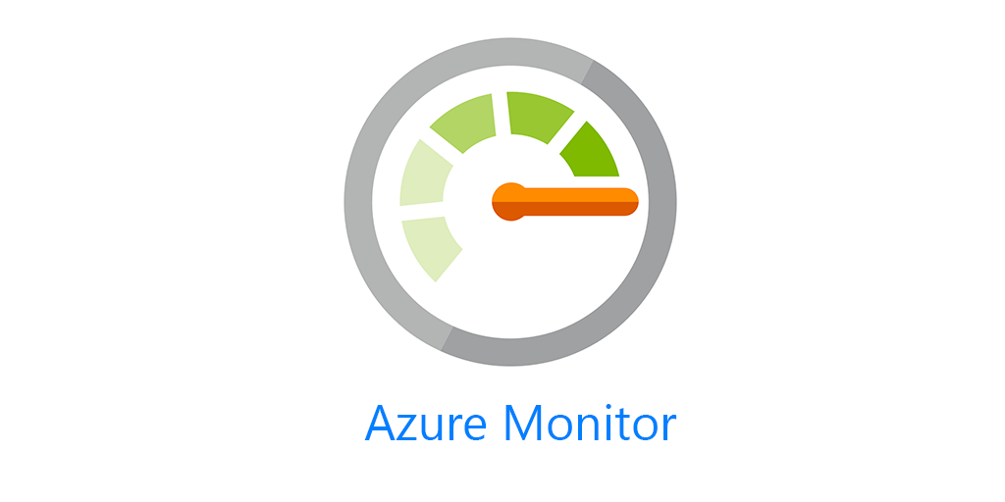











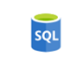


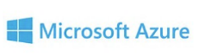








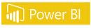


Proven Technology
In production since 2015 for internal Microsoft workload, GA since Feb 2019.
Battle tested for Microsoft internal workload
The platform for analytical solutions (SaaS)
Available as PaaS
Azure Monitor Log Analytics, Application Insights
Security Products (MS Defender for Endpoint (MDATP), MS Sentinel, MS Defender for IoT, MS Defender for Cloud Apps (MCAS))
Azure IoT Central
Gaming platform
https://aka.ms/adx.customers
Notes:
To meet the growing demand of various Microsoft cloud services, Azure Data Explorer was home grown and launched back in 2015. Internally it’s called Kusto and used widely across Microsoft for telemetry analytics. It’s also the underline warm store for Azure Monitor, Application Insights, Azure Security Center, Time Series Insights, IoT Central, and more. All these services offers “a fit for purpose end to end solution”.
This is the same underline technology that we are offering to you as an Azure PaaS service.
© Microsoft Corporation

Slide 8

What is Data Explorer - by the numbers
150 PB
Data ingested
daily
3.5 Billion
Queries per day
15 Exabyte
Total Data Size
4M
VM Cores running
>450K
KQL Developers
A key to Microsoft's digital transformation journey
Notes:
Daily ingest: +47% in 6 mo
Queries: 1B->1.3 - +30% in 6 mo
VM Cores: 1.7->2.4 + 40% in 6 mon
45% of subs are external, 30% of clusters

Slide 9






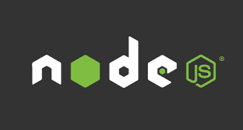



















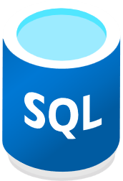
Data Consumption ecosystem
Data Ingestion ecosystem
Query Tools
SDKs
Data Formats
Notebook Connectivity
Managed pipelines
Visualization
Batching
ADX Dashboard
Streaming
API and Client Libraries
REST API
Connection & plugins
Orchestration
Connectors
Tools
TDS, JDBC, ODBC
One Click Ingestion
Export
LightIngest

Slide 10

When to use Data explorer? – How does it fit in the intelligence platform?
Observational Analytics
Interactive
Data Warehousing
Kusto
SQL
Well Curated
Pre-processed
Raw Data
Machine Learning
Batch, long running queries, heavy duty model training
ETL
Notes:
In a Data quadrant, If Data needs to be stored in relational format with all integrity constraints, Data warehousing, updates are necessary, Synapse dedicated SQL pool is the right tool
If long running queries, machine learning over large mount of data dated back to 1 year , complex machine learning is necessary, use Synapse Spark pool
If ad-hoc, interactive queries and real time analysis on logs, telemetry is a requirement, use Azure Data Explorer/Synapse Data Explorer

Slide 11
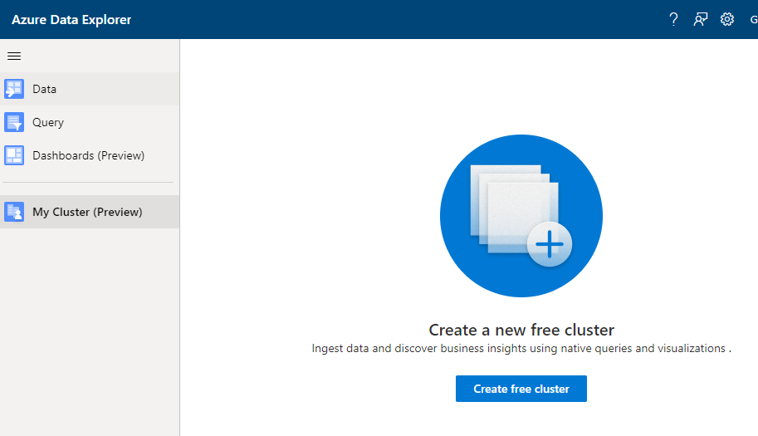
https://aka.ms/adx.free

Slide 12
Personal cluster details
4 vCores, 8GB RAM, ~100GB of data storage (original data)
Up to 10 databases
Up to 100 tables per DB, Up to 200 columns per table
Core functionality

Slide 13
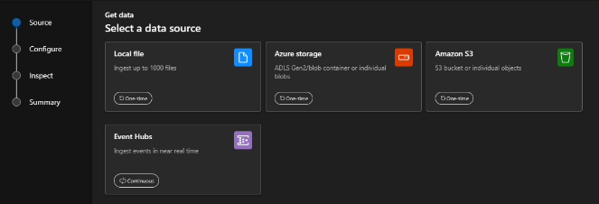
ADX Web UI One-Click (wizard)
Get data from Azure Data Lake, Blob, Event Hub, or local file
Infer the schema automatically from source
Create table and mapping automatically from source
Generate custom code to start ADX project with one of the supported SDKs
Manage data-policies (e.g. retention, batching policies, streaming)
Ingest one-time data or create connection for continuous data ingestion
Continuous (EventHub/EventGrid), one time or backfill (LightIngest)
ADX Web UI
Notes:
Slide is self-explanatory

Slide 14
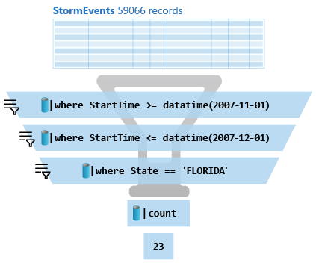
What is a Kusto query?
A Kusto query is a read-only request to process data and return results.
Has one or more query statements and returns data in a tabular or graph format.
Statements are sequenced by a pipe (|). Data flows, or is piped, from one operator to the next.
The data is filtered/manipulated at each step and then fed into the following step. It's like a funnel, where you start out with an entire data table.
Each time the data passes through another operator, it's filtered, rearranged, or summarized.

Slide 15
KQL Concepts
Relational operators (filters, union, joins, aggregations, …)
Each operator consumes tabular input and produces tabular output
Can be combined with ‘|’ (pipe).
Similarities: OS shell, Linq, functional SQL…
Ease to write, read, change
Statements:
Multi-statement (‘;’) queries
Single statement query
Use ‘let’ for reusing statements

Slide 16
KQL Basic operators for data exploration
… | count
Counts records in input table (e.g. T)
… | take 10
Get few records - convenient to start get familiar with the data
No actual order ensured
… | where Timestamp > ago(1) and UserId == ‘abdcdef’
Filtering on a specific fields
… | project Col1, Col2, …
Choose some columns (great if input table has dozens of coluns)
…| extend NewCol1=Col1+Col2
Introduces new calculated columns
… | render timechart
Plot the data (in KE and KWE) while exploring

Slide 17
SQL to KQL
Try the ‘EXPLAIN’ operator as follows
EXPLAIN SELECT COUNT_BIG(*) as C FROM LogisticsTelemetry
Use SQL to KQL Cheat Sheet
Growth mindset 😇

Slide 18
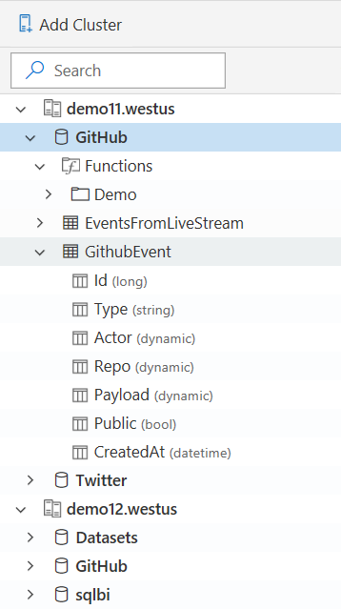
Schema
Schema is
Relational, Lightweight, Dynamic
Databases
Authorization boundary
Transaction boundary
But not query boundary!
Supporting cross-database and cross-cluster queries
Tables
Rectangular
Columns
Supported types: boolean, integer, real, decimal, dates, timespan, string, dynamic (JSON)
Stored functions (views)
Materialized views

Slide 19
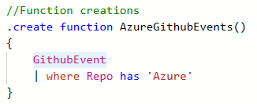
Stored Functions (stored procedures/views)
Essence: Reusable function, defined and used in a Database scope
View is parameter-less function
Schema: scalar or tabular
Special powers: Can override table with the same name.
Safe and Secure: Control commands are forbidden.
Applications:
Sharing queries between users/applications
Abstracting complex logic from other applications
SQL-compat tools connecting to Kusto via Views to run high perf queries

Slide 20
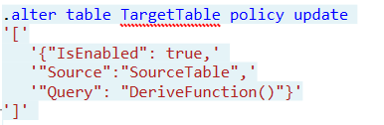
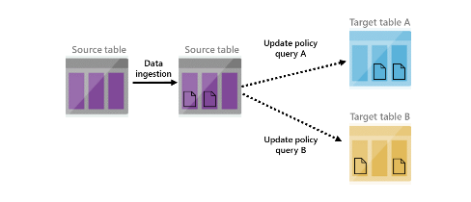
Update Policy (inner ETL/Trigger)
Essence: Triggered ingestion into another table.
Semantics: Attached to ‘target’ table and points on ‘source’ table. Transformation is an arbitrary Kusto query.
Special powers: Source table is scoped to the newly ingested data only.
Applications:
Transform data schema (lightweight ETL)
De-multiplexing data stream into several tables
Use target tables with longer retention
Reduce duplications
Notes:
<Gilles> Update policy is like an internal ETL. It can help you manipulate or enrich the data as it gets ingested into the source table (e.g. extracting JSON into separate columns, creating a new calculated column, joining the new records with a static dimension table that is already in your database, etc). For these cases, using an update policy is a very common and powerful practice. Each time records get ingested into the source table, the update policy's qeury (which we'll define in the update policy) will run on them (and only on newly ingested records - other existing records in the source table aren’t visible to the update policy when it runs), and the results of the query will be appended to the target table.
When you trigger an update policy with a command that adds data to a source table, data also appends to a target table. The target table can have a different schema, retention policy, and other policies from the source table. For example, a high-rate trace source table can contain data formatted as a free-text column. The target table can include specific trace lines, with a well-structured schema generated from a transformation of the source table's free-text data using the parse operator.
Performance impact
Update policies can affect cluster performance, and ingestion for data extents is multiplied by the number of target tables. It's important to optimize the policy-related query. You can test an update policy's performance impact by invoking the policy on already-existing extents, before creating or altering the policy, or on the function used with the query.

Slide 21
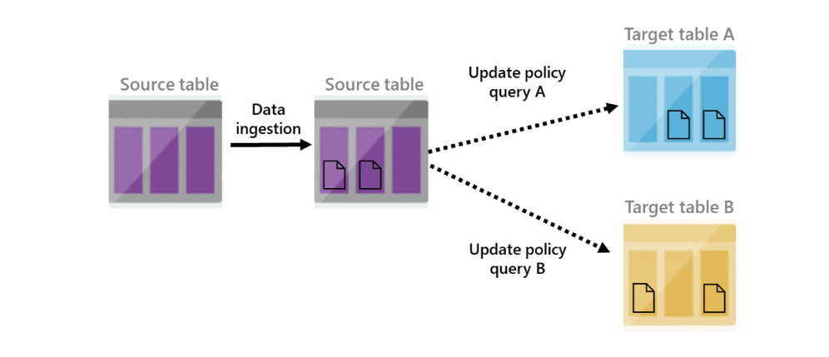
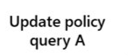

Update Policy
IngestionLogs (244854 records)
ManiputatelogsRaw() filters the newly ingested data
logsRaw
logsRaw + new 3834012 ingested records (not filtered)
Notes:
<Gilles> Source table 'logsRaw' must be referenced in update policy query
Update policy is like an internal ETL. It can help you manipulate or enrich the data as it gets ingested into the source table (e.g. extracting JSON into separate columns, creating a new calculated column, joining the new records with a static dimension table that is already in your database, etc). For these cases, using an update policy is a very common and powerful practice. Each time records get ingested into the source table, the update policy's qeury (which we'll define in the update policy) will run on them (and only on newly ingested records - other existing records in the source table aren’t visible to the update policy when it runs), and the results of the query will be appended to the target table.
When you trigger an update policy with a command that adds data to a source table, data also appends to a target table. The target table can have a different schema, retention policy, and other policies from the source table. For example, a high-rate trace source table can contain data formatted as a free-text column. The target table can include specific trace lines, with a well-structured schema generated from a transformation of the source table's free-text data using the parse operator.
Performance impact
Update policies can affect cluster performance, and ingestion for data extents is multiplied by the number of target tables. It's important to optimize the policy-related query. You can test an update policy's performance impact by invoking the policy on already-existing extents, before creating or altering the policy, or on the function used with the query.

Slide 22
ADX-in-a-Day Guidelines
This is not a hands-on lab. It’s a combination of a lab and a hack. So, use the links, hints, try to solve, or raise your hands.
Screenshots are just examples. Your output may not exactly match the screenshots provided.
Please read the instructions carefully.
Badges will be issued within 24 hours
Submission deadline: before Friday, 21 April 2023, 5 pm CET

Slide 23
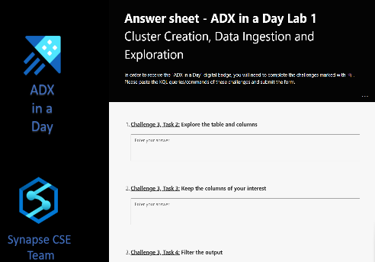
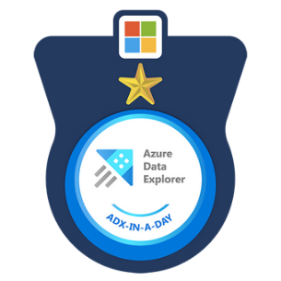
ADX-In-A-Day resources
ADX in a Day – GitHub page
Answer sheet forms
Lab 1
Lab 2
Lab 1 Answer Sheet
Lab 2 Answer Sheet

